Slide 1
Lesson 9 – Stream API

Slide 2
Lesson goals
java.util.Stream
java.util.Optional

Slide 3
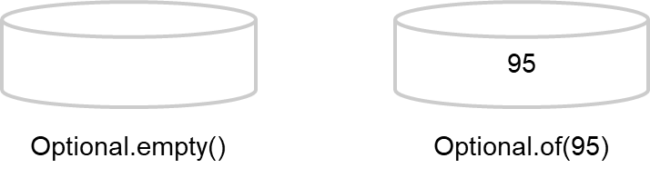
Optional
Optional - “we don’t know” or “not applicable”
created using a factory
a clear way to express that null might be a special value

Slide 4
Optional
Optional.of(…)
Optional.ofNullable(…)
Optional.empty()
From stream terminal operation

Slide 5
Optional methods
T get(); boolean isPresent(); boolean isEmpty(); void ifPresent(Consumer<? super T> action); void ifPresentOrElse(Consumer<? super T> action, Runnable emptyAction); Optional<T> filter(Predicate<? super T> predicate); <U> Optional<U> map(Function<? super T, ? extends U> mapper); <U> Optional<U> flatMap(Function<? super T, ? extends Optional<? extends U>> mapper); Optional<T> or(Supplier<? extends Optional<? extends T>> supplier); Stream<T> stream(); T orElse(T other); T orElseGet(Supplier<? extends T> supplier); T orElseThrow(); <X extends Throwable> T orElseThrow(Supplier<? extends X> exceptionSupplier) throws X;

Slide 6
Optional, working with primitives
OptionalInt: Used for the primitive types int, short, byte, and char
OptionalLong: Used for the primitive type long
OptionalDouble: Used for the primitive types double and float

Slide 7
Primitive Optional methods
long getAsLong();
LongStream stream();
int getAsInt();
IntStream stream();
double getAsDouble();
DoubleStream stream();

Slide 8
Stream
A stream in Java is a sequence of data
A stream pipeline is the operations that run on a stream to produce a result
Finite and Infinite
Lazy evaluated
Not reusable!

Slide 9
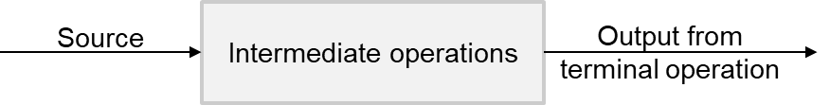
Stream parts
Source
Intermediate operations
Terminal operation

Slide 10
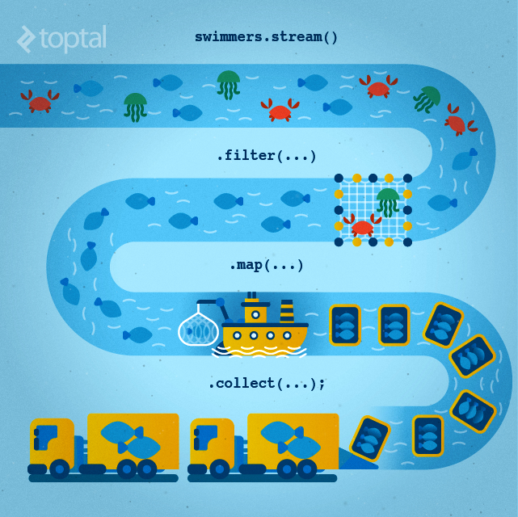
Stream parts

Slide 11
Stream parts
Collection<String> collection = Arrays.asList("John","Simon","Julia","Robert");
List<String> result = collection.stream() //source
.filter(item -> item.startsWith("J")) //intermediate .map(item -> "Saint ".concat(item)) //intermediate .sorted((s1, s2) -> Integer.compare(s2.length(), s1.length())) //intermediate .collect(Collectors.toList()); //terminal
System.out.print(result); // [Saint Julia, Saint John]

Slide 12
Stream source
Stream<String> empty = Stream.empty(); // count = 0
Stream<Integer> singleElement = Stream.of(1,2); // count = 2
Integer[] ints = {1,2,3}; Stream<Integer> fromArray = Stream.of(ints); // count = 3
List<Integer> list = Arrays.asList(1, 2, 3, 4); Stream<Integer> fromList = list.stream(); // count = 4
Stream<String> fromListParallel = list.parallelStream(); // count = 4
Stream<Double> randoms = Stream.generate(Math::random);
Stream<Integer> oddNumbers = Stream.iterate(1, n -> n + 2).limit(10);

Slide 13
Stream intermediate operations
filter() - return a new stream that contains elements that match its predicate.
map() - transform the elements in a stream using the provided java.util.function.Function
flatMap() - transform each element into zero or more elements by a way of another stream
peek() - allows to peek into the stream before an action is encountered
distinct() - find unique elements in a stream according to their .equals() behavior.
sorted() - return a stream sorted according to natural order (or passed comparator)
limit() - limit the number or truncate elements to be processed in the stream
skip() - skip the start elements to be processed in the stream

Slide 14
Stream intermediate operations
Supplier<Stream<Integer>> numbers = () -> Stream.of(5, 4, 1, 3); numbers.get().filter(num -> num > 3).collect(toList()); // [5, 4] numbers.get().map(num -> num * 2).collect(toList()); // [10, 8, 2, 6] numbers.get().peek(System.out::println).collect(toList()); // [5, 4, 1, 3]
numbers.get().distinct().collect(toList()); // [5, 4, 1, 3]
numbers.get().sorted().collect(toList()); // [1, 3, 4, 5] numbers.get().limit(3).collect(toList()); // [5, 4, 1]
numbers.get().skip(2).collect(toList()); // [1, 3]

Slide 15
Stream terminal operations
allMatch() - check every element in the stream and find out if it matches the predicate
anyMatch() - find out whether at least one of the elements in the stream matches a given predicate.
noneMatch() - find if no elements in the stream match the specified predicate
collect() - convert the stream into some other container such as a list.
count() - find the number of elements in the stream
findAny() - find any element in a given stream.
findFirst() - find the first element in the stream
forEach() - perform an action for each element in the stream
min()/max() - find the minimum or maximum of a stream
reduce() - combine the stream elements into one using a BinaryOperator

Slide 16
Stream terminal operations
Supplier<Stream<Integer>> numbers = () -> Stream.of(5, 4, 1, 3); numbers.get().allMatch(n -> n > 0); // true
numbers.get().anyMatch(n -> n > 4); // true
numbers.get().noneMatch(n -> n > 0); // false
numbers.get().map(n -> n * n).collect(toList()); // [25, 16, 1, 9]
numbers.get().count(); // 4 numbers.get().findAny(); // Optional[5] numbers.get().findFirst(); // Optional[5] numbers.get().forEach(System.out::println); // 5 4 1 3
numbers.get().max(comparingInt(n -> n)); // Optional[5] numbers.get().reduce(0, (n1, n2) -> n1 + n2)); // Optional[13]

Slide 17
Stream order and parallel
Encounter order - the order in which the stream source makes it's elements available
Supplier<Stream<Integer>> s = () -> Stream.iterate(1, i -> i + 1).limit(10); s.get().forEach(System.out::print); // 12345678910 s.get().unordered().forEach(System.out::print); // 12345678910 s.get().parallel().forEach(System.out::print); // 78641032195 s.get().parallel().unordered().forEach(System.out::print); // 78109124365

Slide 18
Stream collectors
<R, A> R collect(Collector<? super T, A, R> collector)
<R> R collect(Supplier<R> supplier, BiConsumer<R, ? super T>
accumulator, BiConsumer<R,R> combiner)
Supplier<Stream<Character>> stream = () ->
Stream.of('w', 'o', 'l', 'f', '1', '3') .filter(Character::isLetter) .map(Character::toUpperCase);
stream.get().collect(Collectors.toList())); // [W, O, L, F]
stream.get().collect(StringBuilder::new, StringBuilder::append,
StringBuilder::append)); // WOLF

Slide 19
Stream, working with primitives
IntStream: Used for the primitive types int, short, byte, and char
LongStream: Used for the primitive type long
DoubleStream: Used for the primitive types double and float

Slide 20
Stream, working with primitives
OptionalDouble averageInteger = Stream.of(1.1, 2.6, 3.8) .mapToInt(Double::intValue) .average(); averageInteger.getAsDouble(); // 2.0
OptionalDouble averageInt = IntStream.of(1, 2, 3) .average();
averageInt.getAsDouble(); // 2.0

Slide 21
Stream, working with primitives
IntSummaryStatistics intSummaryStatistics = Stream.of(1, 2, 3) .mapToInt(integer -> integer) .summaryStatistics(); intSummaryStatistics.getMax(); // 3 intSummaryStatistics.getMin(); // 1 intSummaryStatistics.getSum(); // 6 intSummaryStatistics.getAverage(); // 2.0 intSummaryStatistics.getCount(); // 3

Slide 22
Stream methods (from/to) primitives
mapToInt() – transform the elements in a stream into int using the provided ToIntFunction/LongToIntFunction/DoubleToIntFunction
mapToLong() – transform the elements in a stream into long using the provided ToLongFunction/IntToLongFunction/ DoubleToLongFunction
mapToDouble() – transform the elements in a stream into double using the provided ToDoubleFunction/IntToDoubleFunction/LongToDoubleFunction
mapToObj() – transform the elements in a stream into any Object using the provided IntFunction/LongFunction/DoubleFunction
sum() - returns the sum of all elements exist in primitive stream
average() – returns primitive Optional with arithmetic mean of elements in stream
summaryStatistics() – returns various summary data about elements in primitive Stream
boxed() – creates new regular Stream with wrappers instead of values in original primitive Stream

Slide 23
Homework
Change implementation of CodingAudit by using Stream API (all 3 methods can be implemented using streams)
Change implementation of Caeser, Morse, Vigenere codecs by using Stream API (use streams only if they can simplify implementation of the algorithm or reading of the code)

Slide 24
Links
Stream package summary
Streams cheat sheet
Java Stream API
Baeldung collectors
Optional

Slide 25
Thanks!
Any Questions?
Or find us in Slack:
@Yaroslav Brahinets
@Vasya Rudas
@Oleksandr Kucher

